Slide 1


‘lil Library app
By Alison Killen

Slide 2
Other app ideas
Text based game
Star/constellation index
Chose the library because I could visualise how it worked and had lots of scope for improvement

Slide 3

Why this app? + Purpose
I love libraries! And use their services a lot
Wanted to make a simulation of a library app where users can browse+borrow books
For anyone who enjoys libraries

Slide 4
Main functions/user stories
Users can browse books by genre
Users can borrow a book
Users can view account status
Options menu

Slide 5
Logic
Book class – properties + methods
User class – what users can do
Library class – what the library can do
Main app – calling everything
Options module - determines most of control flow

Slide 6
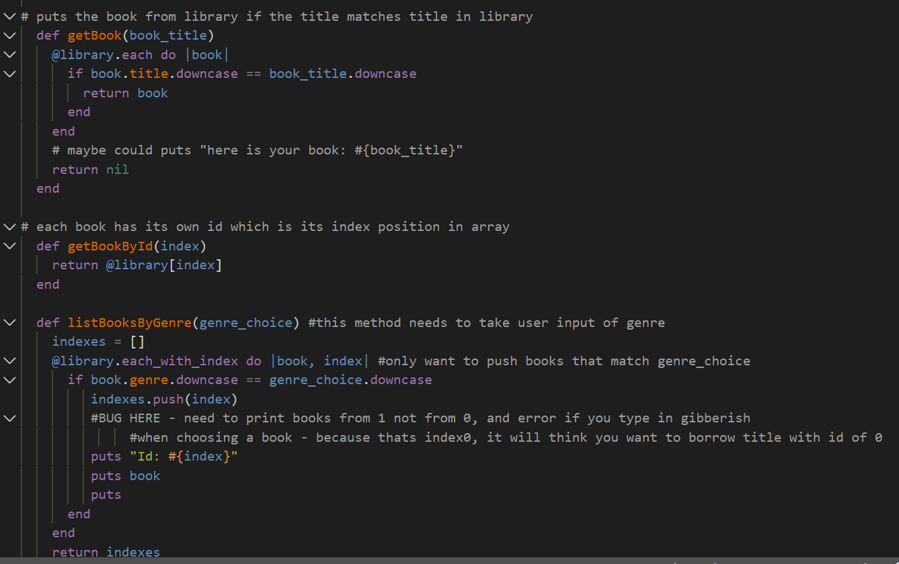
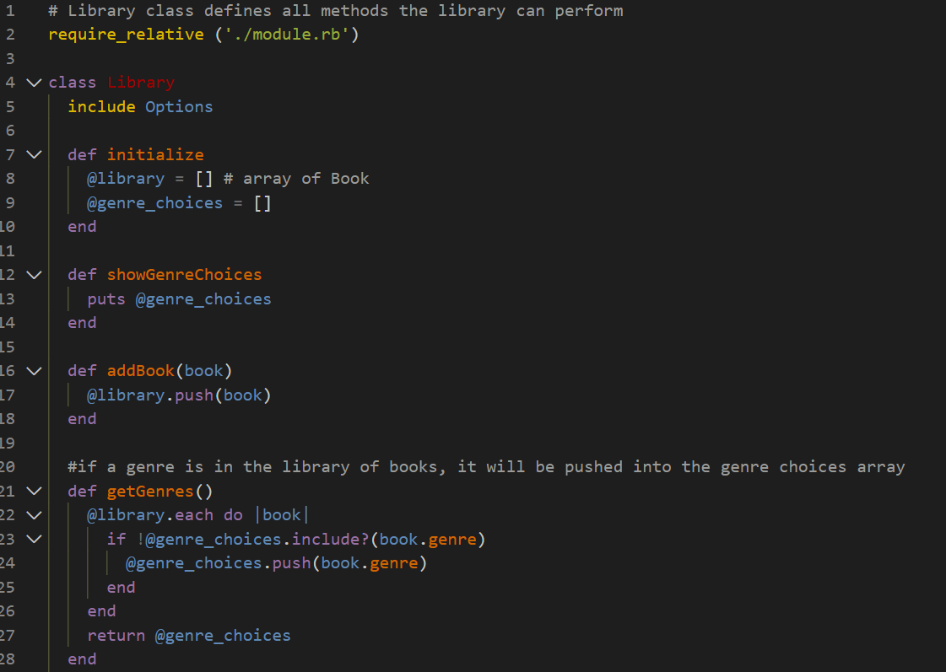
What can the library class do
A few things! Various methods to return for determining list of genres to display, listing those books, enable users to choose genre by number

Slide 7
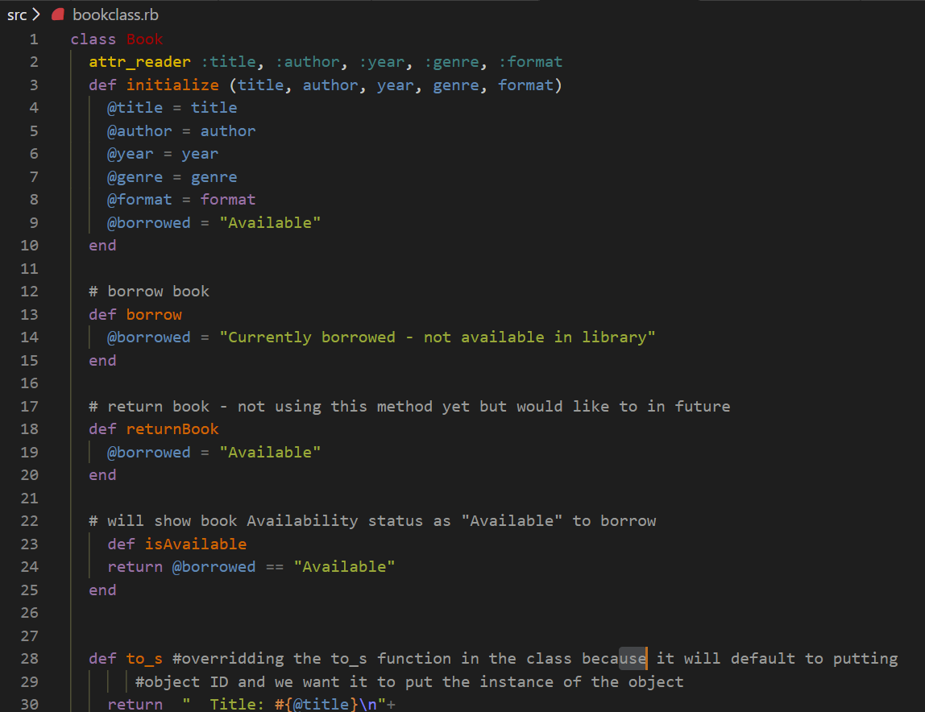
What can the book class do
Initialises a book with title, author, year, genre, format, borrowed attributes
Can set a book as available or not available

Slide 8
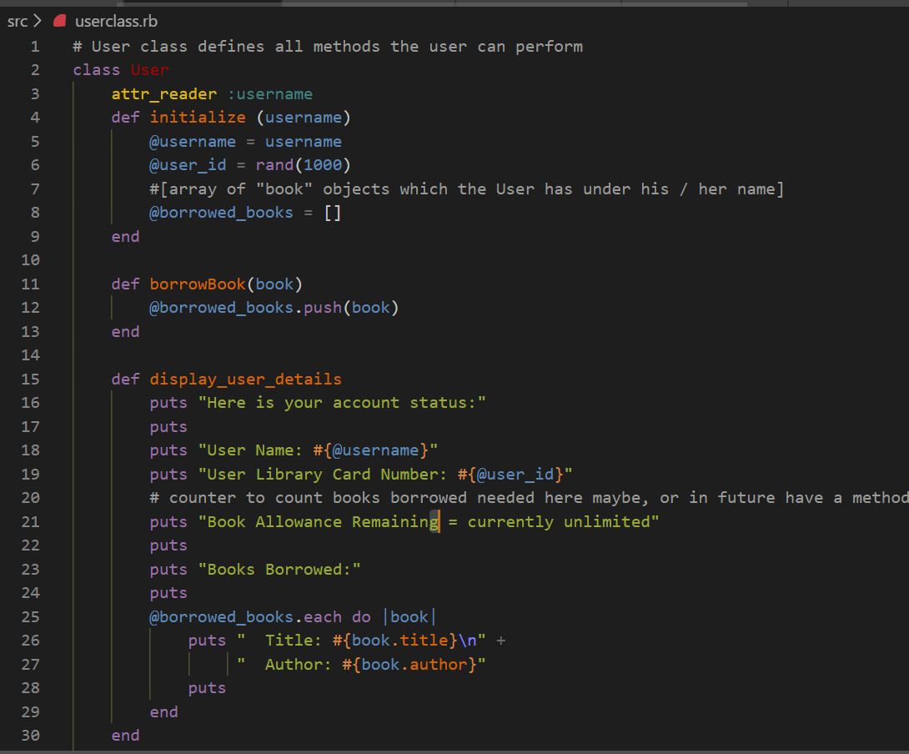
What can the user class do
Initialises user class with username and user_id, borrowed books array
Borrowbook method pushes chosen book object into borrowed books array
Display user details…..displays the user details. Displays users borrowed books by iterating over borrowed books array and putting each title/author

Slide 9
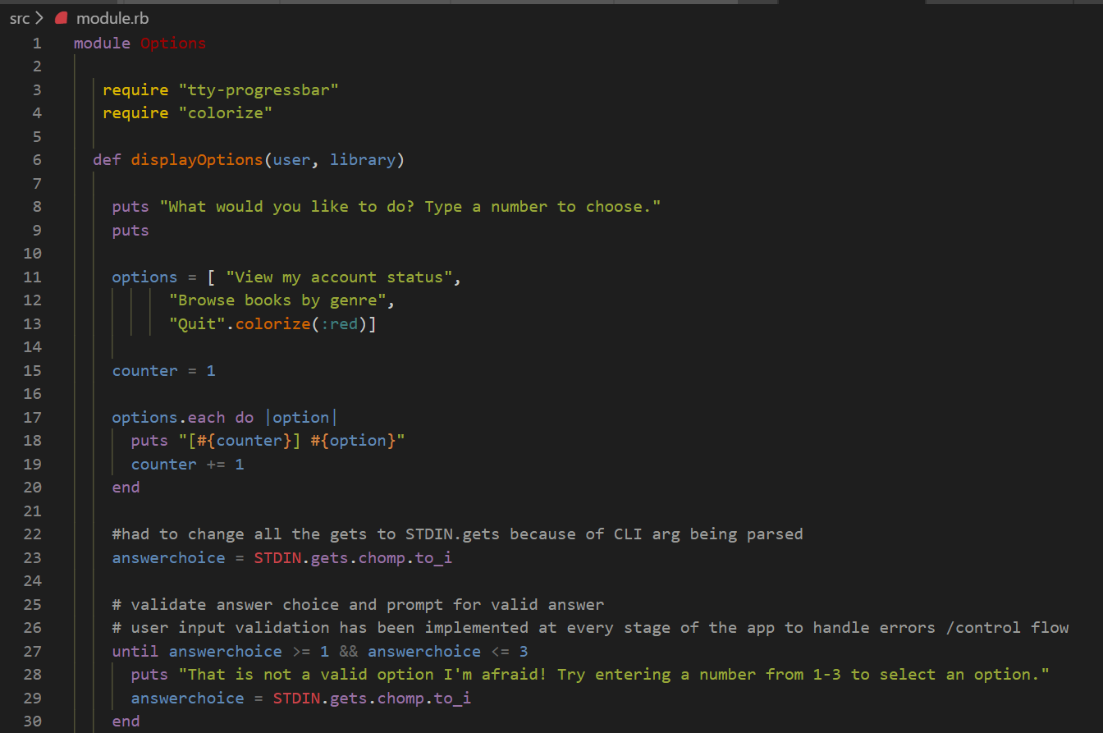
The module – aka the options menu
Most of the code is here
Enables users to interact with and manipulate library data
Displays options and gets number to choose
Method for displaying user details
Method for getting genre user wants to browse
Execute options choices, validates, and then loop back to options menu
Defines handle_borrowed_book which checks if book is borrowed or not and if not sets it as borrowed if user wants to borrow it
Defines handlequit method that allows users to confirm and quit app

Slide 10
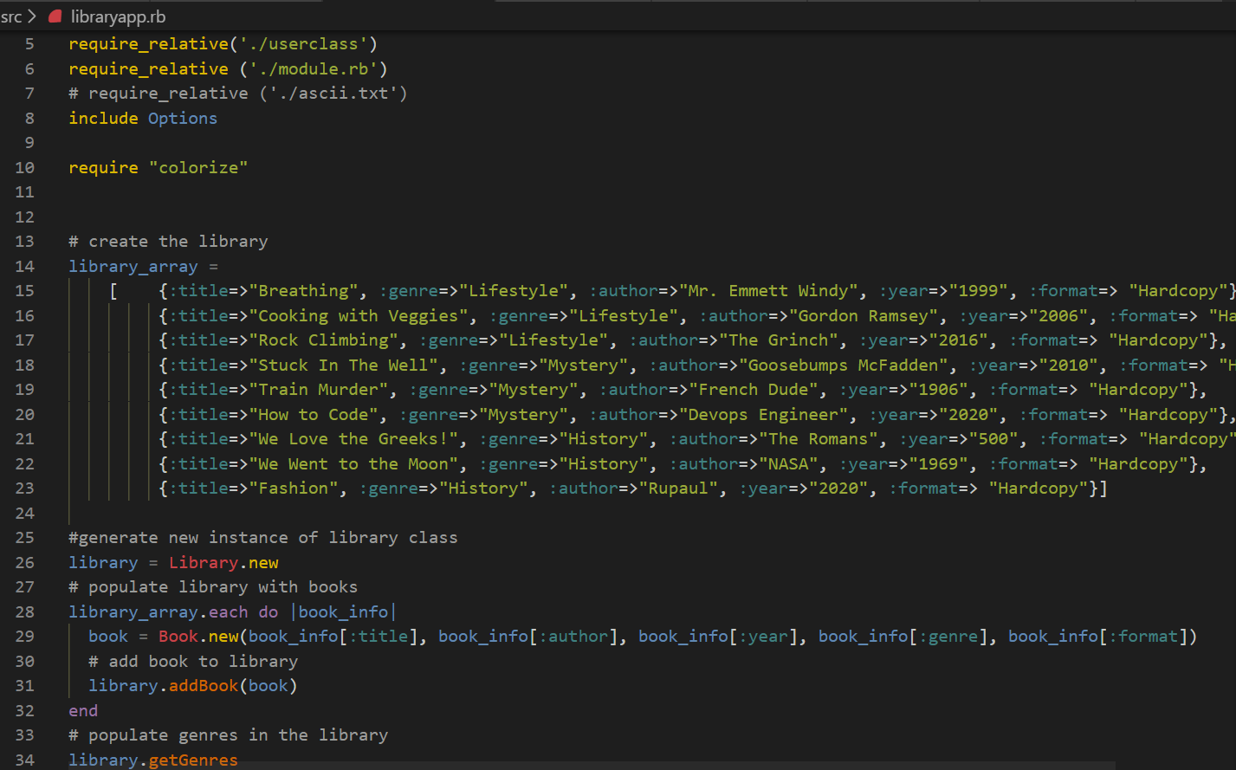
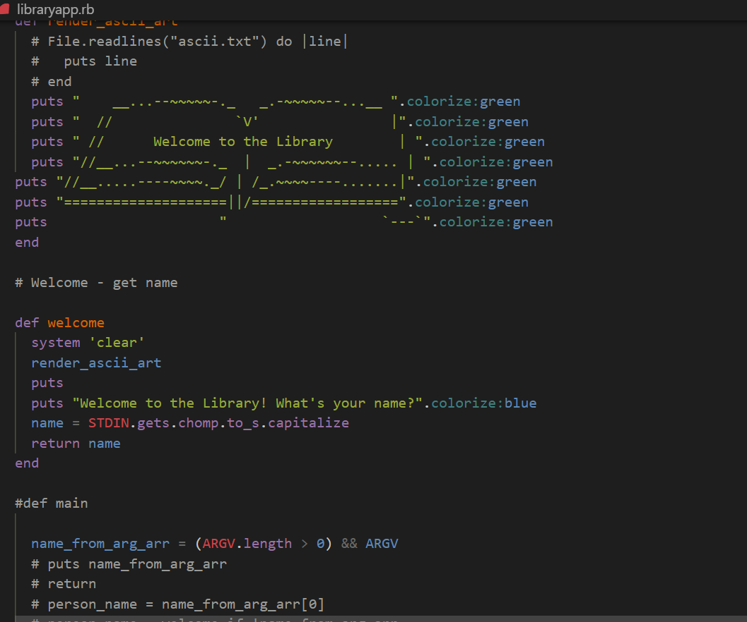
The main app
Requires other files
Contains library hash
Creates new library and populates it with books
Method to render ascii art
Defines welcome method to get user name
If user passes name in from CLI arg in shell script, it will use that name
If user doesn’t pass name in, it will get name using welcome method
Runs options module on loop – all methods etc called from here

Slide 11

Struggles
So many to choose from!
Understanding classes and defining methods within them
Control flow, making sure nothing breaks the app – testing, testing, testing
Understanding how to use diff methods within a class method (modules)
Felt like one step forward, five steps back - Making some new feature and then it breaks everything
Options menu – refactoring all control flow and restructuring around it

Slide 12

Learnings
The 3 C’s - Coding, coffee, crying
Development journal helped keep me on track and keep me sane
Pattern of work – plan sections, breaks, flow state, explain it to somebody
Classes
Importance of control flow – redid diagram lots – think about it earlier
More commits = more happiness (for when you break everything)
Love your error messages
Comment well
INDENT as you go. Otherwise end errors everywhere
Keep refining control flow - make everything modular asap
Don’t worry about making it pretty at first

Slide 13
Scope for Improvement/Additional Features
Had to scrap a lot of features I thought of for the sake of keeping it simple
Right now is single user/single session
Add more gems/make it pretty
Limit on amount of books they can borrow
Put not available books on “hold”
Late fees function
Users can add books to the library
Return a book feature – (scrapped)
More genres + books – generated by faker
More book formats – ebooks, audiobooks (scrapped)
Accessibility – speech to text
Library of Alexandria ‘skin’ – with cool art and book titles

Slide 14
Thank you!
Thank you so much to all the educators! Shoutout to Janel for spending lots of time with me in the mornings and to Simon for helping me with gems and scripting
Thanks to all classmates on discord ☺

